Slide 1
Chapter 7 3D Geometric Transformations
Resumes of the book
Computer Graphics using Java 2D and 3D
Computação Gráfica
Prof. Carlos Carreto
Engenharia Informática
Instituto Politécnico da Guarda

Slide 2
Objectives
Describe the 3D geometric transformations.
Construct affine 3D geometric transformations, such as translation, rotation, scale variation, shear and reflection.
Understand and apply transformation matrices.
Apply transformations to a scene graph.
Build and apply composite transformations.
Apply transformations to the construction of geometries.

Slide 3
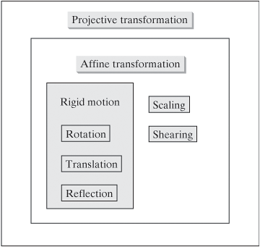
3D Afine Transformations
Map lines in lines and preserve parallelism.
Preserve the distances.

Slide 4
3D Afine Transformations
Matrix representation of a
3D affine transformation:
Using homogeneous coordinates we standardize the representation of the geometric transformations only through the multiplication of matrices:

Slide 5
Matrix Classes
Java 3D contains classes to represent different types of arrays:
Matrix3f
Matrix3d
Matrix4f
Matrix4d
Gmatrix
double[] array = {1.0, 2.0, 3.0, 1.0,
0.0, 1.0, -1.0, 2.0,
4.0, 0.0, 0.5, -1.0,
0.0, 0.0, 0.0, 1.0};
Matrix4d matrix = new Matrix4d(array);
double[] array = {1.0, 2.0, 3.0, 1.0,
0.0, 1.0, -1.0, 2.0,
4.0, 0.0, 0.5, -1.0}; GMatrix matrix = new GMatrix(3, 4, array);
5

Slide 6
Matrix Classes
Basic operations between arrays are supported by an extensive set of methods:
void add(Matrix4d m1)
void sub(Matrix4d m1)
void mul(Matrix4d m1)
void invert()
void add(Matrix4d m1, Matrix4d m2)
void sub(Matrix4d m1, Matrix4d m2)
void mul(Matrix4d m1, Matrix4d m2)
void invert(Matrix4d m1)
void transpose()
void mul(double scalar)
double determinant()
6

Slide 7
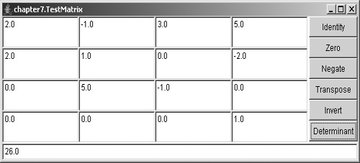
Matrix Classes
Code 7.1
Code 7.2
Run
7

Slide 8
Transform3D Class
Used to represent a related 3D transformation or a projective transformation.
Internally it maintains a 4x4 matrix of double type with the values of the transformation.
The default constructor creates an identity array, but the class contains several constructors that receive different objects.
Example:
double[] array = {1.0, 2.0, 3.0, 1.0,
0.0, 1.0, -1.0, 2.0,
4.0, 0.0, 0.5, -1.0,
0.0, 0.0, 0.0, 1.0};
Matrix4d matrix = new Matrix4d(array);
GMatrix gmatrix = new GMatrix(4, 4, array);
Transform3D transform1 = new Transform3D(matrix); Transform3D transform2 = new Transform3D(gmatrix); Transform3D transform3 = new Transform3D(array);
8

Slide 9
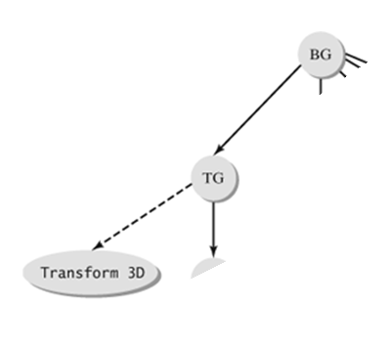
Transform3D Class
In a scene graph, a TransformGroup node uses an object of type Transform3D to define its transformation.
9

Slide 10
Transform3D Class
The class has several methods for configuring and manipulating the transformation matrix:
void set(Matrix4d m1)
void set(Matrix4f m1)
void set(GMatrix m1)
void set(double[] array)
void set(float[] array)
void get(Matrix4d m1)
void get(Matrix4f m1)
void get(GMatrix m1)
void get(double[] array)
void get(float[] array)
. . .
The transformation can also be defined in terms of specifications of geometric transformations such as translations, scales, rotations and shearing.
10

Slide 11
Transform3D Class Translation
Each point is moved by the quantities b₁, b₂ and b₃, in the directions x, y and z, respectively.
The shape and orientation of the object are not changed.
The inverse transformation of a translation of b₁, b₂ and b₃ is a translation of -b₁, -b₂ and -b₃.
The set method completely replaces the current transformation with the specified translation.
The setTranslation methods modify only the translation components of the current transform.
void set(Vector3d trans)
void set(Vector3f trans)
void setTranslation(Vector3d trans)
void setTranslation(Vector3f trans)
11

Slide 12
Transform3D Class Scale
Each point undergoes a scale variation given by factors s₁, s₂ and s₃, in the directions x, y and z, respectively.
The transformation is invertible if all scale factors are different from 0. The factors of the inverse scale variation are 1/s₁, 1/s₂ and 1/s₃.
A variation of scale is uniform if s₁ = s₂ = s₃.
The set method completely replaces the current transformation with the specified translation.
The setScale methods modify only the scale variation components of the current transform.
void set(double scale)
void setScale(double scale)
void setScale(Vector3d scales)
12

Slide 13
Transform3D Class Reflection
In 3D the reflection is performed in relation to a plane.
A simple reflection in relation to the xy-plane is given by the following matrix.
A reflection is always invertible and the inverse reflection is reflection itself.
A reflection on a plane passing through the origin with the normal vector u is given by:
13

Slide 14
Transform3D Class Shearing
In 3D the shear changes the position of a point relative to one axis, in proportion to the position of the point relative to another axis.
The following examples exemplify changing the x and y coordinates proportionally to the z coordinate.
14

Slide 15
Transform3D Class Rotation
A generic 3D rotation has an axis of rotation that can be any line in space. A point is rotated about this axis from a fixed angle. For example, the rotation of an angle θ around the z-axis is given by the following matrix:
Notice the similarity to the 2D rotation matrix
Although any rotation can be represented by a transformation matrix, it is in general difficult to obtain such a matrix from the specification of a generic rotation. For example, what is the rotation matrix of an angle π/3, about the axis (1, 1, 1)?
15

Slide 16
Transform3D Class Rotation
To facilitate the specification of generic rotations API Java 3D supports quaternions that simplify the specification of generic rotations in relation to axes that pass through the origin. Thus, a generic rotation can be specified by the function
void set(AxisAngle4d r).
AxisAngle4d()
AxisAngle4d(AxisAngle4d a1)
AxisAngle4d(AxisAngle4f a1)
AxisAngle4d(double[] a)
AxisAngle4d(double x, double y, double z, double angle)
AxisAngle4d(Vector3d axis, double angle)
16

Slide 17
Quaternions and 3D Rotation
Representation of a point as a pure quaternion:
A rotation can be defined by the following operations between quaternions:
Where θ is the angle of rotation and u defines an axis of rotation that passes through the origin.
17

Slide 18
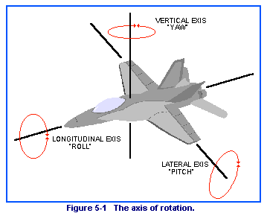
Euler Angles
Another popular way to represent a 3D rotation is to use 3 R₃R₂R₁ rotations, from certain angles, around the axes of the coordinate system.
The angles have different names depending on the context:
(elevation, azimuth, tilt)
(roll, pitch, yaw)
(precession, nutation, spin)
(heading, altitude, bank)
A rotation with Euler angles can be specified by the method:
void setEuler(Vector3d eulerAngles)
18

Slide 19
Conversion from Quaternions to Euler Angles
public static Vector3d quatToEuler(Quat4d q1) {
double sqw = q1.w*q1.w;
double sqx = q1.x*q1.x;
double sqy = q1.y*q1.y;
double sqz = q1.z*q1.z;
double heading = Math.atan2(2.0 * (q1.x*q1.y + q1.z*q1.w),(sqx - sqy - sqz + sqw));
double bank = Math.atan2(2.0 * (q1.y*q1.z + q1.x*q1.w),(-sqx - sqy + sqz + sqw));
double attitude = Math.asin(-2.0 * (q1.x*q1.z - q1.y*q1.w));
return new Vector3d(bank, attitude, heading);
}
19

Slide 20
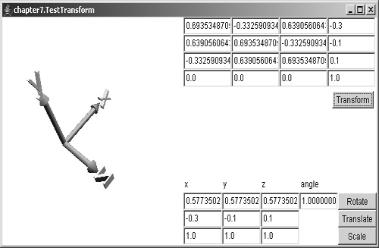
Transform3D Class Demonstration
Code
Run
20

Slide 21
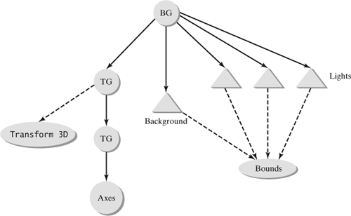
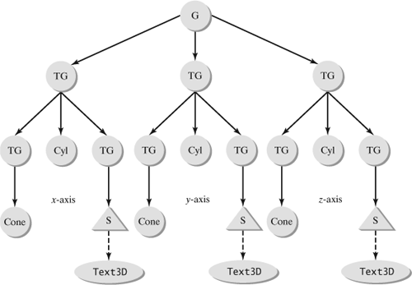
Transform3D Class Demonstration
User defined transformation.
Construction of Axes.
Axes positioning (scale variation).
21

Slide 22
TransformGroup Node
Transformations are implemented in the scene graph through the TransformGroup class.
An object of type TransformGroup defines a node-group in the scene graph that represents a specific transformation.
The exact form of the transformation is specified by a Transform3D object, referenced by the node.
The transformation defined by the cluster-node is applied to all of its descendant nodes.
22

Slide 23
TransformGroup Node
Example 1
double[] array = {1.0, 2.0, 3.0, 1.0,
0.0, 1.0, -1.0, 2.0,
4.0, 0.0, 0.5, -1.0,
0.0, 0.0, 0.0, 1.0};
Matrix4d matrix = new Matrix4d(array);
Transform3D transform = new Transform3D(matrix);
TransformGroup node = new TransformGroup(transform);
Example 2
Tetrahedron geom = new Tetrahedron();
Shape3D shape = new Shape3D();
shape.setGeometry(geom);
Transform3D tr = new Transform3D();
tr.setTranslation(new Vector3d(0.5,0,-1));
TransformGroup tg = new TransformGroup(tr); tg.addChild(shape);
23

Slide 24
TransformGroup Node
A TransformGroup node can be a descendant of another TransformGroup node. In this way a hierarchy of transformations can be constructed and other nodes can be constructed to represent complex structures of geometric models.
24

Slide 25
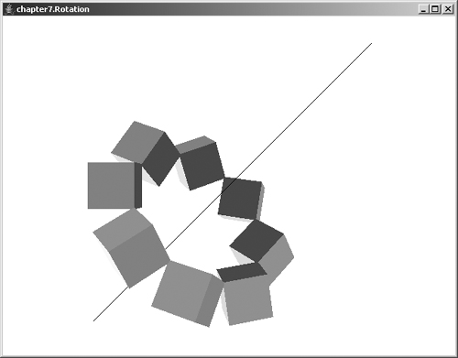
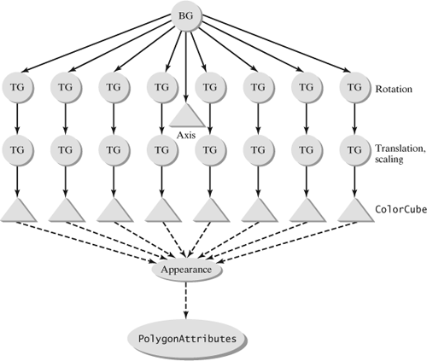
TransformGroup Node Demonstration
Code
Run
25

Slide 26
Composite Transforms
Two or more transformations can be combined to form a more complex transformation:
(T₂T₁)(p) = (T₂(T₁(p))
The composition of transformations is not usually commutative:
T₁T₂ ≠ T₂T₁
In the notation used, the composition of transformations is applied from right to left.
In matrix form, the composition of transformations corresponds to the multiplication of the matrices of each transformation.
To create a complex transformation, it is usually simpler to compose the transformation from basic transformations, than to create the array directly.
26

Slide 27
Composite Transforms
transformation is known in a standard position, a similar transformation in a more generic position can be obtained by following the steps:
Turn the original position to the standard position;
Carry out the transformation in its standard form;
Turn the standard position to the original position.
27

Slide 28
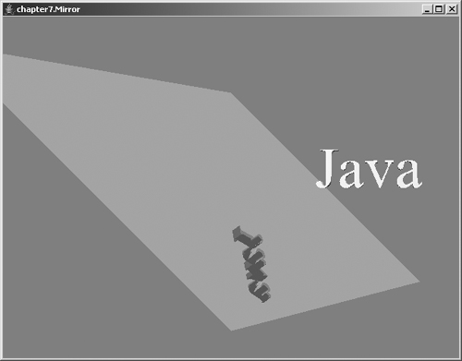
Composite Transforms Reflection Example
RSR⁻¹
Code
Run
28

Slide 29
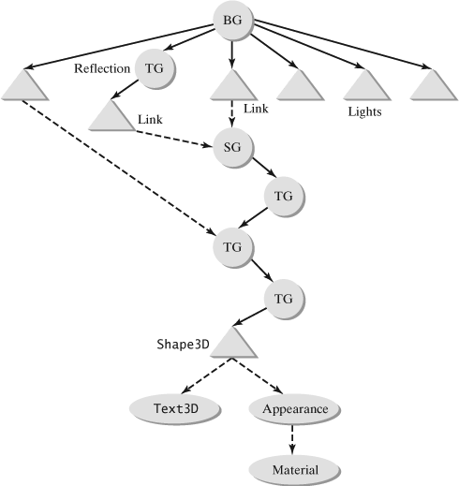
Composite Transforms Reflection Example
Composite transformation RSR⁻¹ (Rotation for the plane coincides with one of the planes of the coordinate system, in case XY; Scale variation in Z to create the symmetry; Inverse rotation).
Shape positioning (scale variation and translation).
Rotation (through a behavior).
Positioning of the Shape (reverse translation of the previous one to rotate on the axis itself).
29

Slide 30
Constructing Geometries with Transformations
The geometric primitives often exhibit certain degrees of symmetry, so some of the vertices of the primitives can be obtained by transforming other vertices.
There are several techniques based on this idea to construct graphical primitive geometries.
30

Slide 31
Constructing Geometries with Transformations
The Transform3D class contains methods for applying the transformation represented by the object, points, or vectors:
void transform(Point3d p)
void transform(Point3d p, Point3d pOut)
void transform(Point3f p)
void transform(Point3f p, Point3f pOut)
void transform(Vector3d v)
void transform(Vector3d v, Vector3d vOut)
void transform(Vector3f v)
void transform(Vector3f v, Vector3f vOut)
void transform(Vector4d v)
void transform(Vector4d v, Vector4d vOut)
void transform(Vector4f v)
void transform(Vector4f v, Vector4f vOut)
31

Slide 32
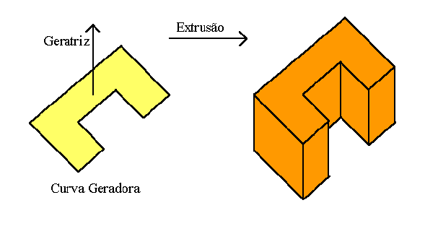
Constructing Geometries Extrusion
A translation is applied, in a given direction, to the points of the original 2D curve to create the new points of the 3D geometry.
Code
32

Slide 33
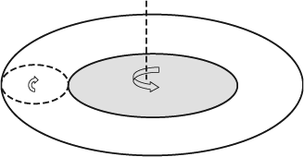
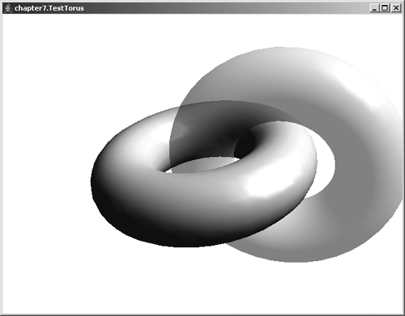
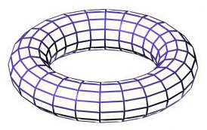
Constructing Geometries Rotation
Code
Run
33

Slide 34
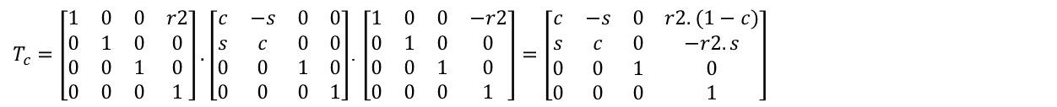
Construction of a Torus
P0 = (r1+r2, 0, 0)
r1
r2
Initial slice
To generate the initial "slice" points, we apply a rotation of the initial point P0 around the circumference of radius r1.
As the circumference is not centered on the origin, we apply the following compound transformation to generate the desired rotation:
$$T_{c}=T_{\left(r2, 0, 0\right)}.R_{θ}.T_{(−r2, 0, 0)} \text{Considerar} c=\cos{θ e s=\sin{θ}}$$
$T_{c}=\left[\begin{matrix}1 & 0 & 0 & r2 \\ 0 & 1 & 0 & 0 \\ 0 & 0 & 1 & 0 \\ 0 & 0 & 0 & 1\end{matrix}\right].\left[\begin{matrix}c & −s & 0 & 0 \\ s & c & 0 & 0 \\ 0 & 0 & 1 & 0 \\ 0 & 0 & 0 & 1\end{matrix}\right]$. $\left[\begin{matrix}1 & 0 & 0 & −r2 \\ 0 & 1 & 0 & 0 \\ 0 & 0 & 1 & 0 \\ 0 & 0 & 0 & 1\end{matrix}\right]=\left[\begin{matrix}c & −s & 0 & r2.(1−c) \\ s & c & 0 & −r2.s \\ 0 & 0 & 1 & 0 \\ 0 & 0 & 0 & 1\end{matrix}\right]$
34

Slide 35
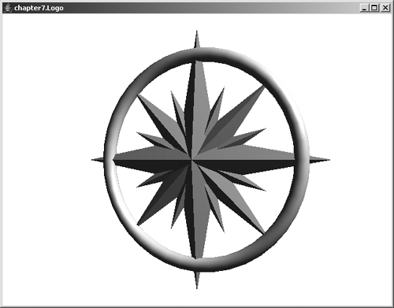
Constructing Geometries Transformation and Shared Branch
Code
Run
35

